Slide 1
Satellite/Aerial Image Retrieval
Rui zou
Yanbo Deng
Ruhui Shen

Slide 2
Content
Introduction
Our Method
Result

Slide 3
Introduction

Slide 4
Our Goal
Given two points in geo coordinate, return the map image bounded by the two points with acceptably finest resolution.
Use Bing Map Tile System to obtain the required highest resolution Aerial Image.

Slide 5
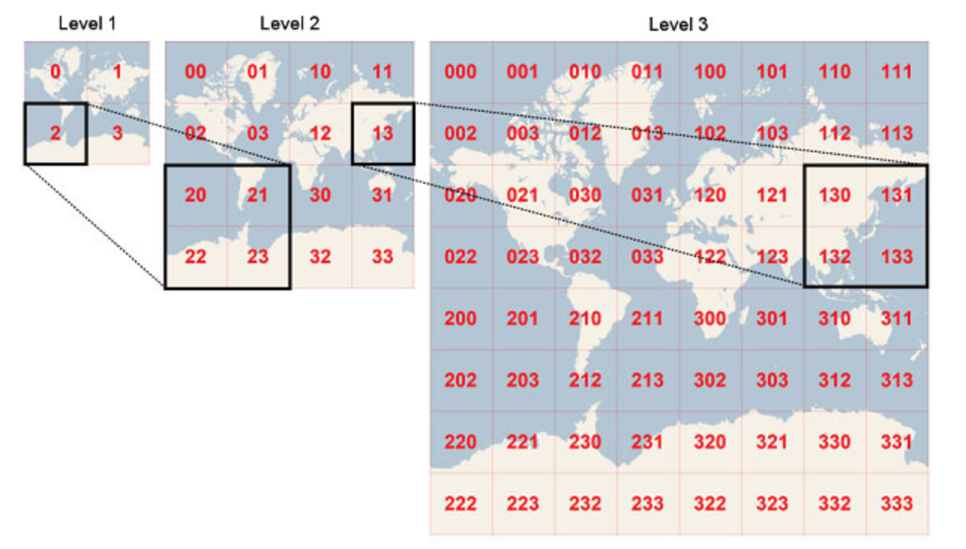
Bing Maps Tile System
Project the world map to a square number of pixels. A bunch of pixels consist a tile orderly.
In higher level, there are more pixels, bigger map size, more tiles, and finer ground resolution. There are 23 levels in total. Each tile in current level expand to 4 tiles in next finer level.

Slide 6
Bing Maps Tile System (Con.)
Tile System
Quadkey
23 Levels
Each Level: L
Each Tile:
23-L levels
Each Tile
Tile Coordinates
Pixel Coordinates

Slide 7
Our Method

Slide 8
Tools We used
Python 3.6
Package: Pillow
Bing Map Tile System

Slide 9
Query a Aerial Image from Bing Map Tile System
Apply for Bing Map license key:
Our key is: Al30EKo-GBnLPGUklNlRe9Np1b8akY7joyIA74skrj9LISIQv99uL3WEk_VLgvzM
Query from URL by quadkey:
http://ho.ortho.tiles.virtualearth.net/tiles/h#quadkey.jpeg?g=131&key=#license_key
#quadkey: can be generated by converting a pair of latitude and longitude.
#license_key: is our license key above.
Extract the socket and obtain the queried tile image.

Slide 10
Generate Bounding Box of Aerial Image
Base Tile
Find the smallest tile which bounds everything of our bounding box.
Inside this base tile, recursively find finest tiles.
Finest Tile
From level 23 to lower levels, find the first non-null tile aerial images.
Stitch these tiles together to generate a “finest tile”
Cropping
Convert Longitudes and latitudes to pixel coordinates in the finest tile.
Crop the finest tile to the bounding box of required aerial image.

Slide 11
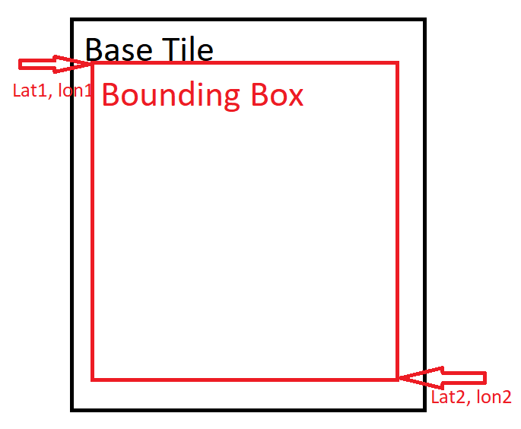
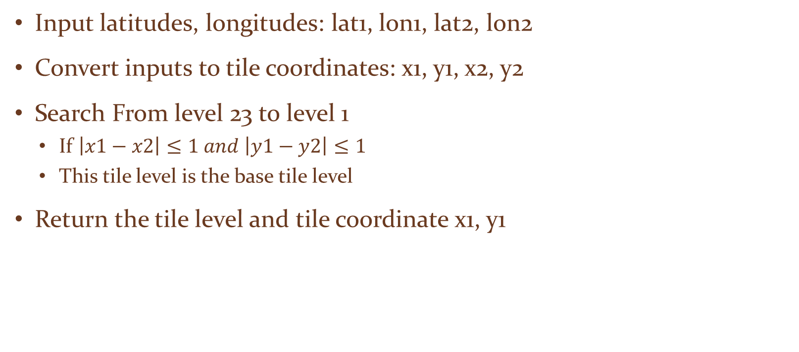
Base Tile
Input latitudes, longitudes: lat1, lon1, lat2, lon2
Convert inputs to tile coordinates: x1, y1, x2, y2
Search From level 23 to level 1
If $\left|x1−x2\right|≤1 and \left|y1−y2\right|≤1$
This tile level is the base tile level
Return the tile level and tile coordinate x1, y1

Slide 12
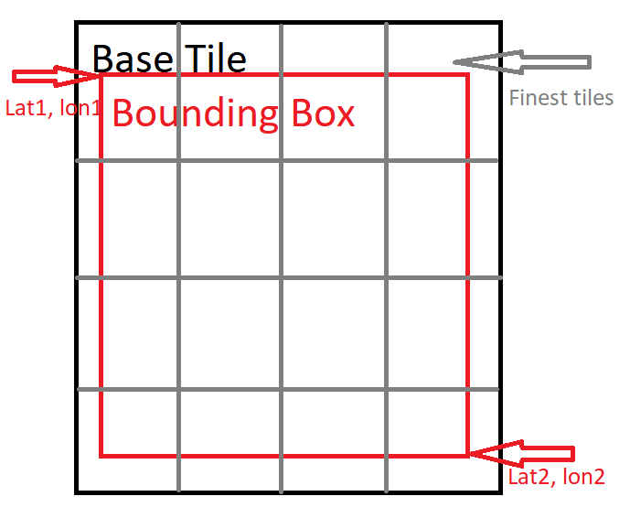
Finest Tile
Input tile coordinates: x1, y1, x2, y2 and tile level.
From level 23 to base tile level:
If we can query all tile images in this level,
Return all tile images inside base tile.
Stitch these tile images together to generate finest tile image.
Return finest tile image.

Slide 13
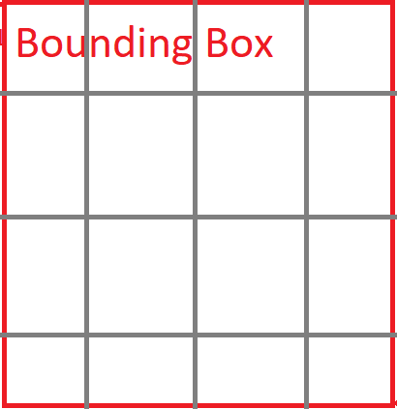
Cropping
Input: lat1, lon1, lat2, lon2 and finest tile image.
Convert latitudes and longitudes into pixel coordinates of finest tile.
Cropping finest tile image by the pixel coordinates to generate required bounding box of aerial image.
Return the bounding box image.

Slide 14
Results

Slide 15
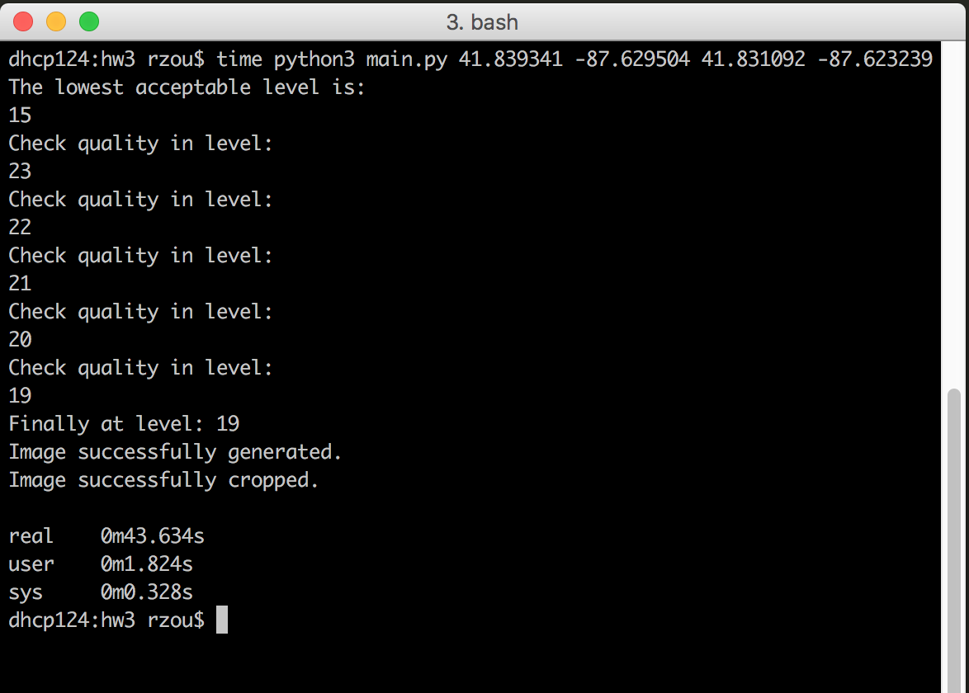
Runtime Screenshot

Slide 16
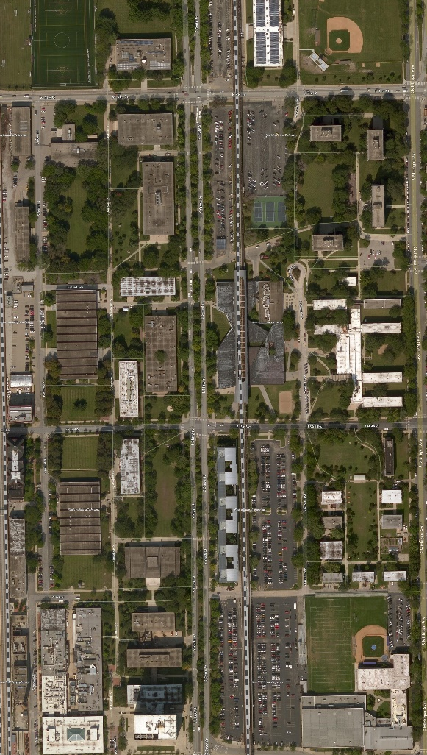
Aerial Image of IIT
Bounding Box:
Top Left Corner:
Latitude: 41.839341
Longitude: -87.629504
Bottom Right Corner:
Latitude: 41.831092
Longitude: -87.623239

Slide 17
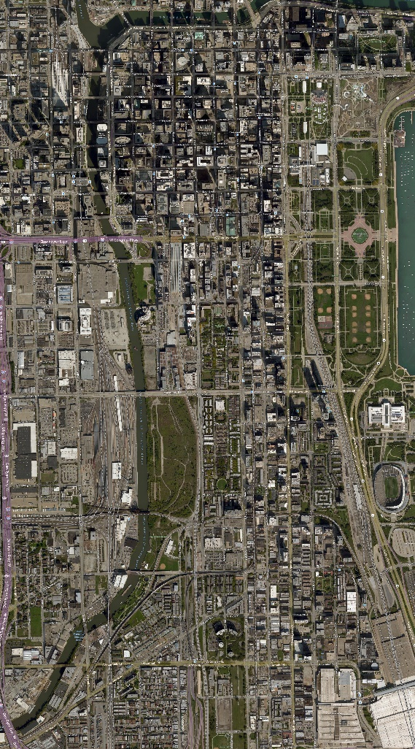
Aerial Image of Chicago Loop
Bounding Box:
Top Left Corner:
Latitude: 41.888438
Longitude: -87.644858
Bottom Right Corner:
Latitude: 41.848298
Longitude: -87.614988

Slide 18
Thanks！

